Slide 1
Project Closure
Silver & Stones

Slide 2
Improvements?
Full-fledged web application
Larger, more relevant photographs
Responsive design
Inventory management system
Photo gallery
There’s a Facebook!!!!

Slide 3
Product Review

Slide 4
Final vs. Initial?
What’s different?
Photo gallery
Customizable text and pictures
Hold system instead of Stripe payments
More robust email system
What didn’t change?
Inventory management
User roles
Overall site layout

Slide 5
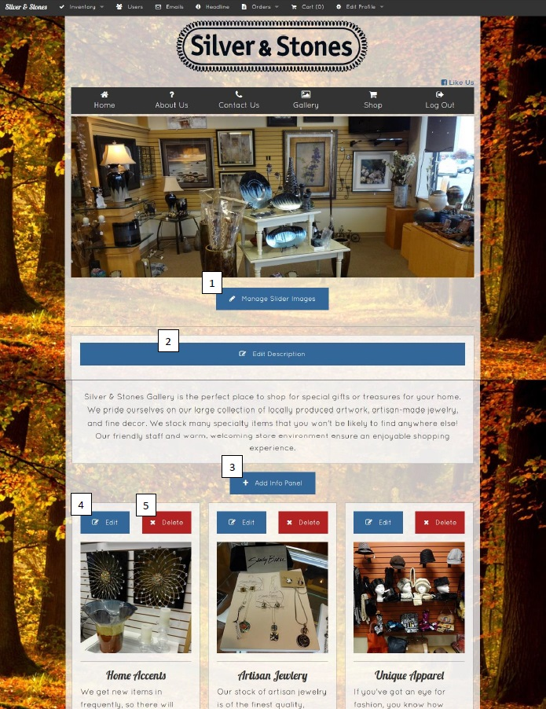
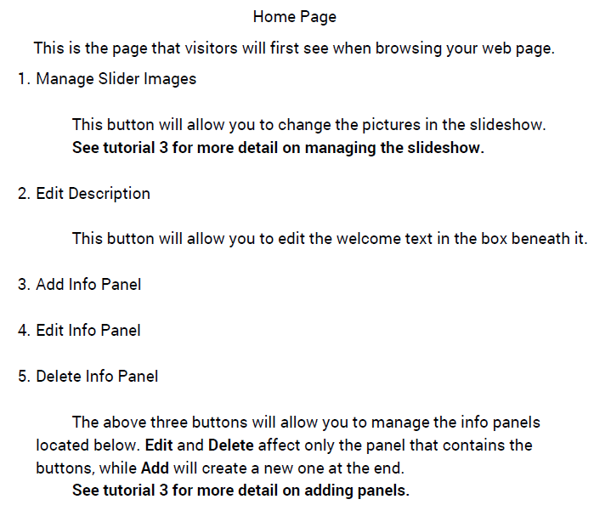
Reference Book

Slide 6
Final vs. Initial?
What’s different?
Photo gallery
Customizable text and pictures
Hold system instead of Stripe payments
More robust email system
What didn’t change?
Inventory management
User roles
Overall site layout

Slide 7
Client Review

Slide 8
Delivery
Meeting with client soon to “deliver”
Hand over resource book
Training meeting with staff
Future application maintenance will fall to anyone with server access
Likely Ben for now, but could theoretically be anyone able to ssh
Application administration is baked right into the app
Wanted to leave code in a state that allowed outside parties to extend, use, and maintain it.

Slide 9
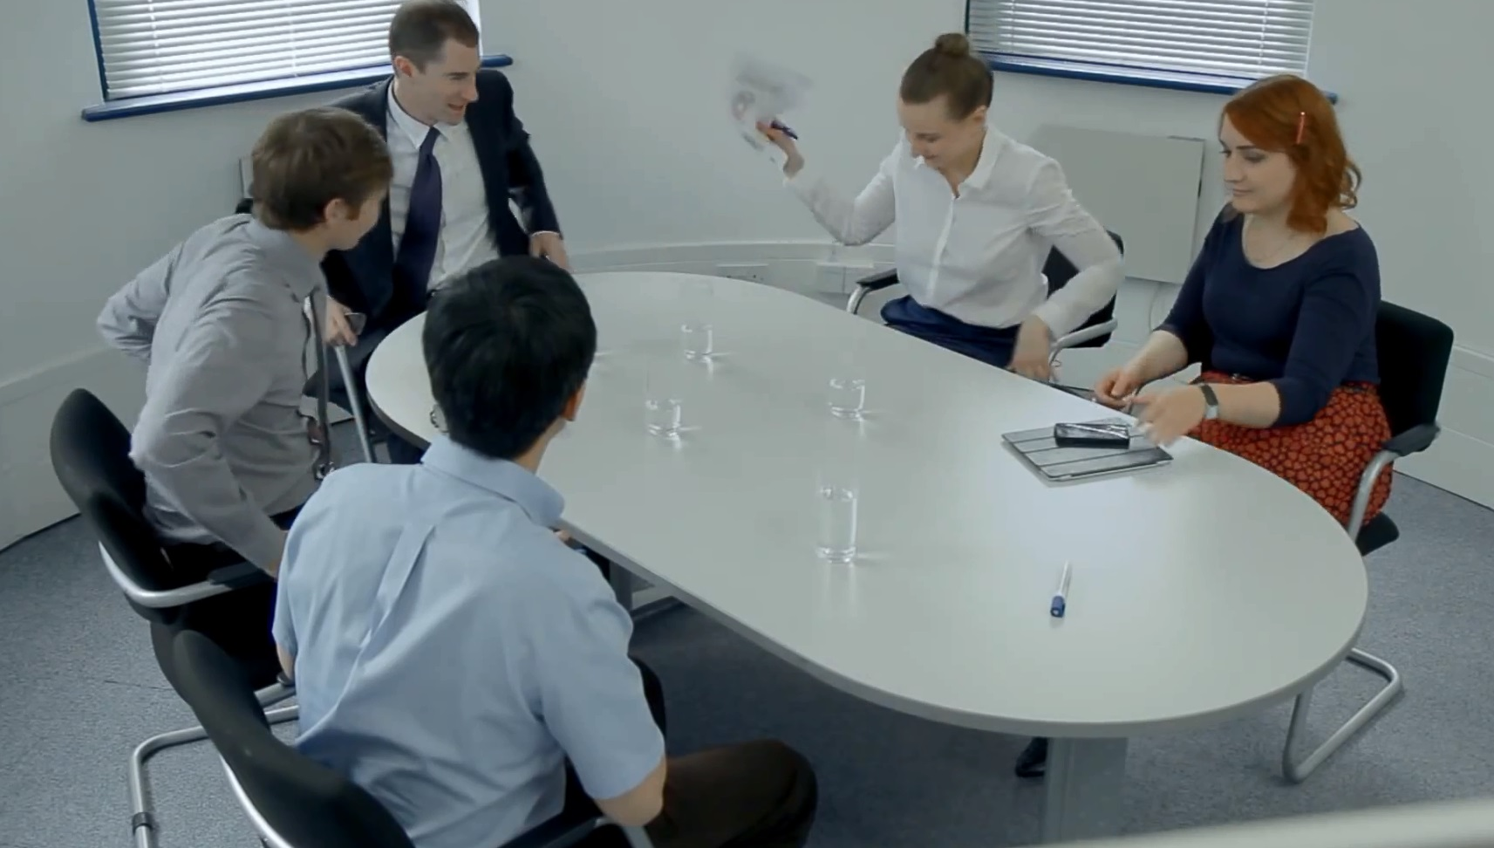
Working with Clients

Slide 10
Working with Clients
Schedule meetings early
Some clients do not want “Agile” response
Post-sprint meetings seem “pointless”
Give them what they need, not what they want!
Ultimately, it’s all about meeting the client’s needs
frex, no online payments
Being polite goes a long way

Slide 11
Process Review

Slide 12
Scrum Pros
Similarity to actual Agile process
Liberty to work on other classwork due to loose deadlines
Enough sprints to accommodate a medium-sized project
Used proper task tracker (Acunote)

Slide 13
Scrum Cons
Couldn’t push work out of third sprint
Most Agile shops run sprints alternating with “testing week”
For example, 3 week sprints with 1 week of testing
“Rabbit Hole” tasks
Task appears easy, but is in actuality very difficult or complex
May require a full sprint to do

Slide 14
Doing it over
Do more work in the first sprint
Meet with the client much more frequently early on
Discuss the implications of Stripe payments before the first sprint
Plan for bulk of work to be finished by Sprint 2
Sprint 3: The Return of the Testing Sprint
Next time, none of us would have OS…

Slide 15
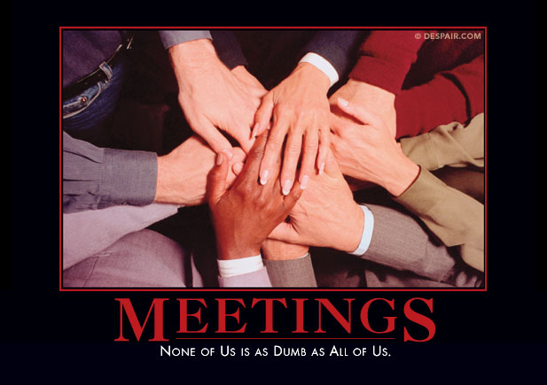
Working with classmates

Slide 16
Working with classmates
Classmates have work to do too
Set aside more time for “bringing up to speed”
Not everyone’s skill set is the same
Good project management is absolutely necessary
Version control is a godsend

Slide 17
Questions?

